Slide 1
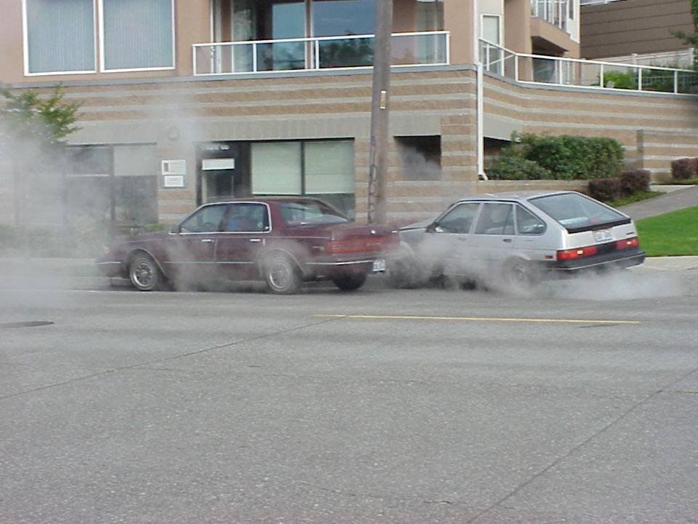
Vehicle Dynamics
CEE 320
Steve Muench

Slide 2
Outline
Resistance
  Aerodynamic
  Rolling
  Grade
Tractive Effort
Acceleration
Braking Force
Stopping Sight Distance (SSD)

Slide 3
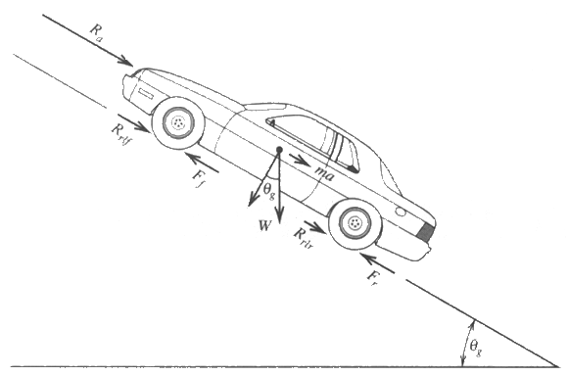
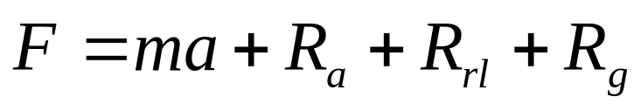
Main Concepts
Resistance
Tractive effort
Vehicle acceleration
Braking
Stopping distance

Slide 4
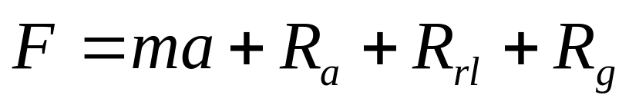
Resistance
Resistance is defined as the force impeding vehicle motion
  What is this force?
  Aerodynamic resistance
  Rolling resistance
  Grade resistance

Slide 5
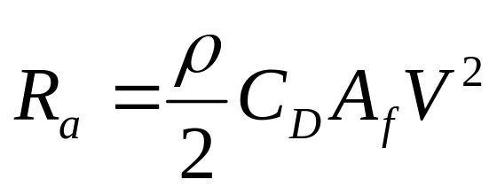
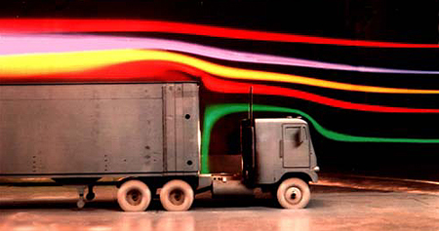
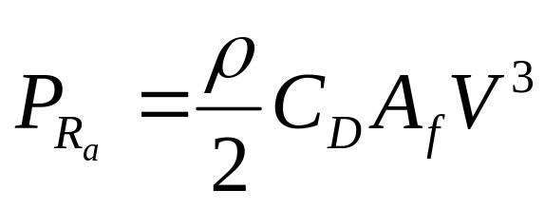
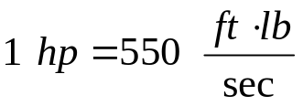
Aerodynamic Resistance R_{a}
Composed of:
  Turbulent air flow around vehicle body (85%)
  Friction of air over vehicle body (12%)
  Vehicle component resistance, from radiators and air vents (3%)
from National Research Council Canada
Notes:
Power is in ft-lb/sec

Slide 6
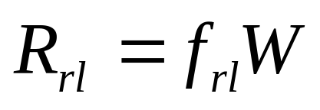
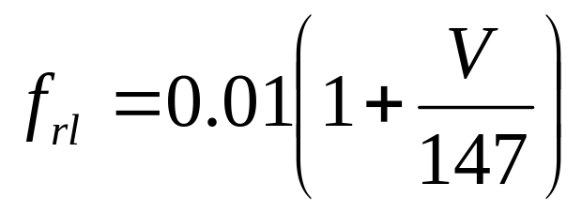
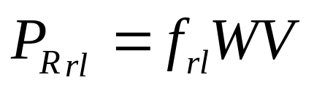
Rolling Resistance R_{rl}
Composed primarily of
  Resistance from tire deformation (∼90%)
  Tire penetration and surface compression (∼ 4%)
  Tire slippage and air circulation around wheel (∼ 6%)
  Wide range of factors affect total rolling resistance
  Simplifying approximation:
Notes:
Rolling resistance = 2 components
Hysteresis = energy loss due to deformation of the tire
Adhesion = bonding between tire and roadway

Slide 7
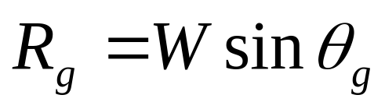
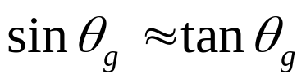

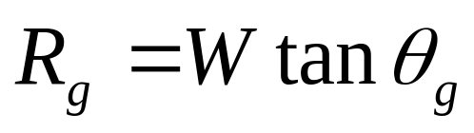
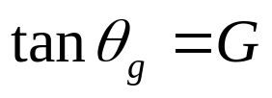
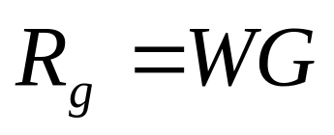
Grade Resistance R_{g}
Composed of
  Gravitational force acting on the vehicle
θ_{g}
For small angles,
R_{g}
θ_{g}
W

Slide 8
Available Tractive Effort
The minimum of:
  Force generated by the engine, F_{e}
  Maximum value that is a function of the vehicle’s weight distribution and road-tire interaction, F_{max}

Slide 9
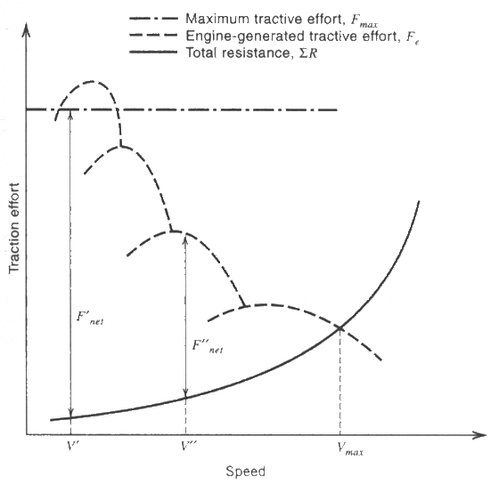
Tractive Effort Relationships

Slide 10
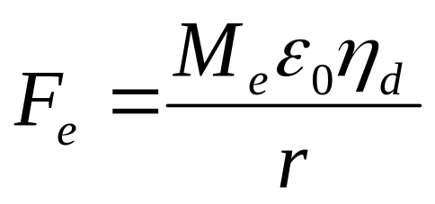
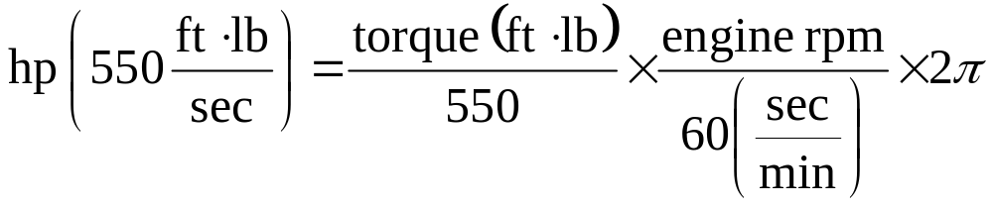
Engine-Generated Tractive Effort
F_{e} | = | Engine generated tractive effort reaching wheels (lb)
M_{e} | = | Engine torque (ft-lb)
ε₀ | = | Gear reduction ratio
η_{d} | = | Driveline efficiency
r | = | Wheel radius (ft)
Force
Power
Notes:
Low profile tires reduce r and increase tractive effort

Slide 11
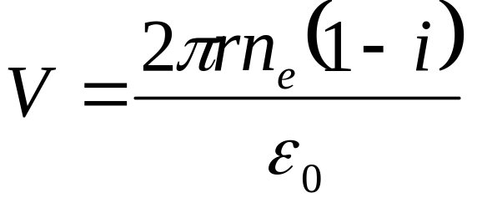
Vehicle Speed vs. Engine Speed
V | = | velocity (ft/s)
r | = | wheel radius (ft)
n_{e} | = | crankshaft rps
i | = | driveline slippage
ε₀ | = | gear reduction ratio

Slide 12
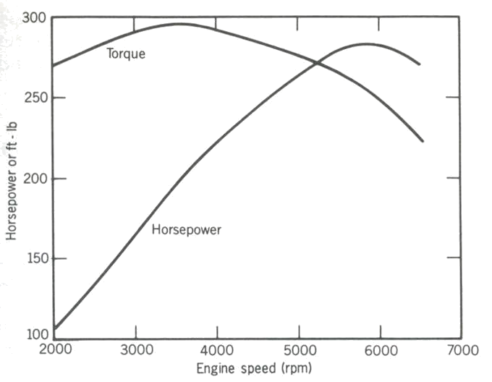
Typical Torque-Power Curves
Notes:
Torque and HP always cross at 5252 RPM. Why? Look at the equation for HP

Slide 13
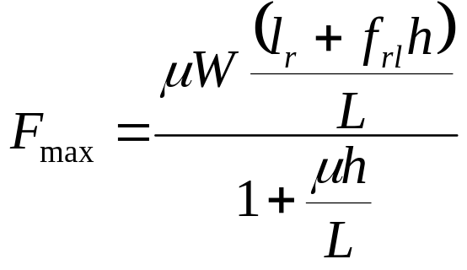
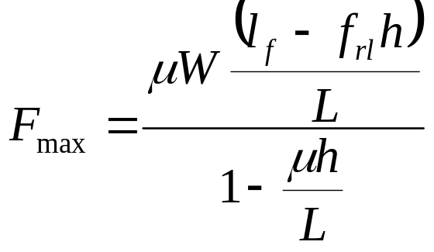
Maximum Tractive Effort
Front Wheel Drive Vehicle
Rear Wheel Drive Vehicle
What about 4WD?
Notes:
For 4WD
F_{max} = μW (if your 4WD distributes power to ensure wheels don’t slip, which is common)

Slide 14
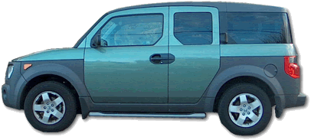
Diagram
R_{a}
h
R_{rlf}
ma
h
W_{f}
W
F_{bf}
θ_{g}
l_{f}
R_{rlr}
l_{r}
W_{r}
L
F_{br}
θ_{g}
Notes:
For a front wheel drive car, sum moments about the rear tire contact point:
-R_{a}h – Wsinθh + Wcosθl_{r} + mah - W_{f}L = 0
cosθ = about 1 for small angles encountered
-R_{a}h – Wsinθh + Wl_{r} + mah - W_{f}L = 0
W_{f}L = -R_{a}h – Wsinθh + Wl_{r} + mah
W_{f}L = + Wl_{r} – Wsinθh – R_{a}h + mah
W_{f} = (l_{r}/L)W + (h/L)(-Wsinθ – R_{a} + ma)
But… Wsinθ = R_{g}
Substituting: W_{f} = (l_{r}/L)W + (h/L)(-R_{g} – R_{a} + ma)
We know that… F = ma + R_{a} + R_{rl} + R_{g} Therefore, -F + R_{rl} = -ma – R_{a}– R_{g}
W_{f} = (l_{r}/L)W + (h/L)(-F + R_{rl})
Now, F_{max} = μW_{f} and R_{rl} = f_{rl}W
Substituting: F_{max} = μ((l_{r}/L)W + (h/L)(-F_{max} + f_{rl}W))
Simplifying: F_{max} + (μh/L)F_{max} = μ((l_{r}/L)W + (h/L)(f_{rl}W))
F_{max}(1 + μh/L) =( μW/L)((l_{r} + hf_{rl})

Slide 15
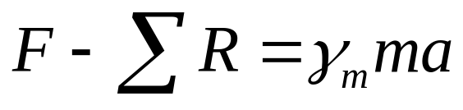
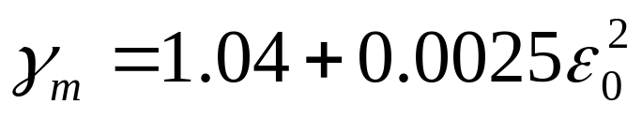
Vehicle Acceleration
Governing Equation
Mass Factor
  (accounts for inertia of vehicle’s rotating parts)

Slide 16
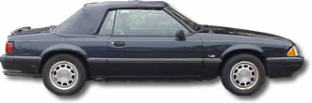
Example
A 1989 Ford 5.0L Mustang Convertible starts on a flat grade from a dead stop as fast as possible. What’s the maximum acceleration it can achieve before spinning its wheels? μ = 0.40 (wet, bad pavement)
1989 Ford 5.0L Mustang Convertible
Torque | 300 @ 3200 rpm
Curb Weight | 3640
Weight Distribution | Front 57% Rear 43%
Wheelbase | 100.5 in
Tire Size | P225/60R15
Gear Reduction Ratio | 3.8
Driveline efficiency | 90%
Center of Gravity | 20 inches high
Notes:
Tire size
P = passenger car
1st number = tire section width (sidewall to sidewall) in mm
2nd number = aspect ratio (sidewall height to width) in tenths (e.g. 60 = 0.60)
3rd number = wheel diameter

Slide 17
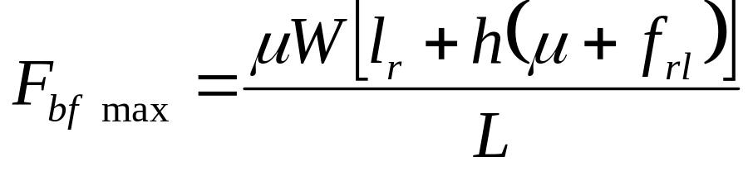
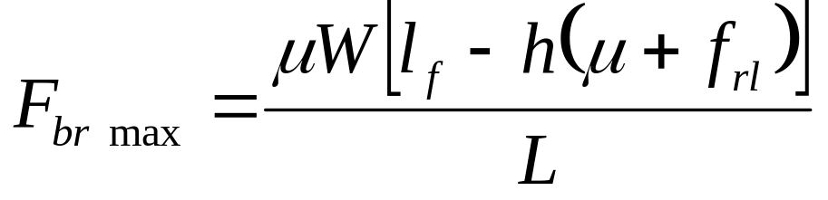
Braking Force
Front axle
Rear axle

Slide 18
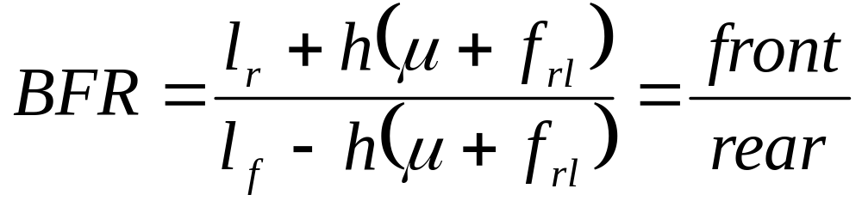
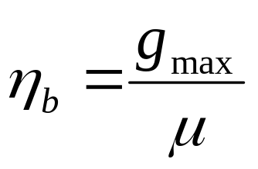
Braking Force
Ratio
Efficiency

Slide 19
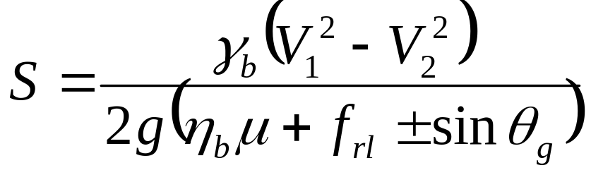
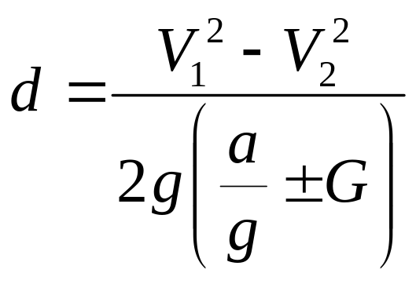
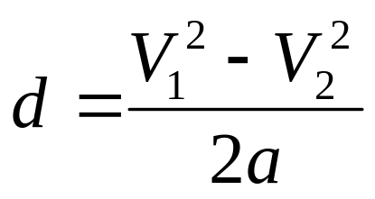
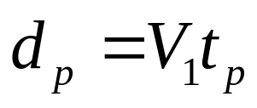
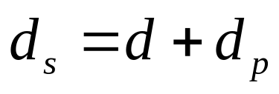
Braking Distance
Theoretical
  ignoring air resistance
Practical
Perception
Total
For grade = 0
Notes:
Practical comes from V₂² = V₁² + 2ad (basic physics equation or rectilinear motion)
a = 11.2 ft/sec² is the assumption
This is conservative and used by AASHTO
Is equal to 0.35 g’s of deceleration (11.2/32.2)
Is equal to braking efficiency x coefficient of road adhesion
γ_{b} = 1.04 usually

Slide 20
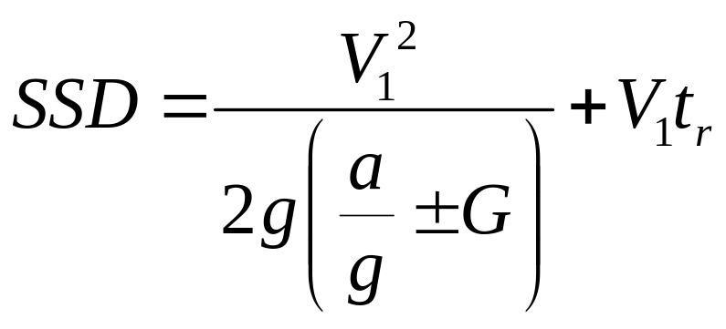
Stopping Sight Distance (SSD)
Worst-case conditions
  Poor driver skills
  Low braking efficiency
  Wet pavement
Perception-reaction time = 2.5 seconds
Equation

Slide 21
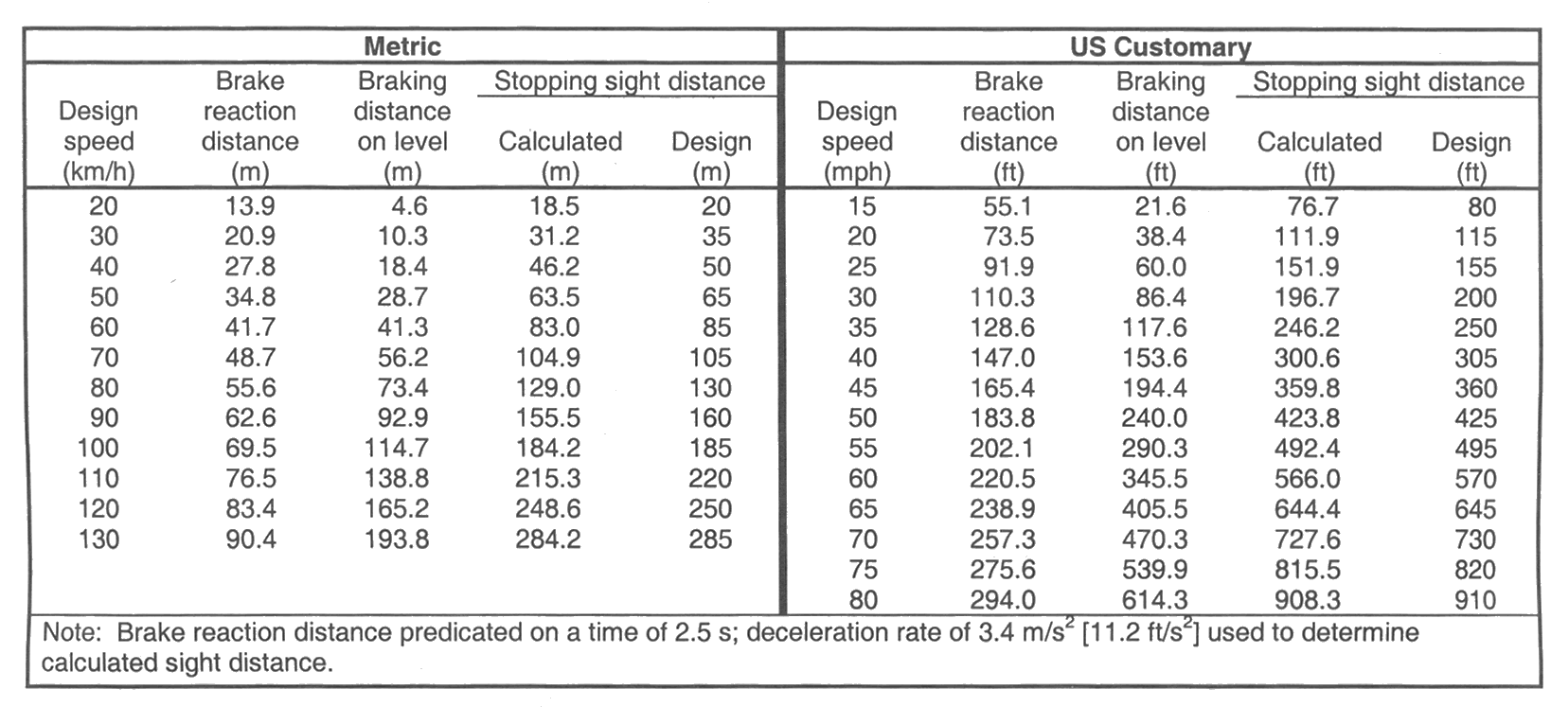
Stopping Sight Distance (SSD)
from ASSHTO A Policy on Geometric Design of Highways and Streets, 2001
Note: this table assumes level grade (G = 0)

Slide 22

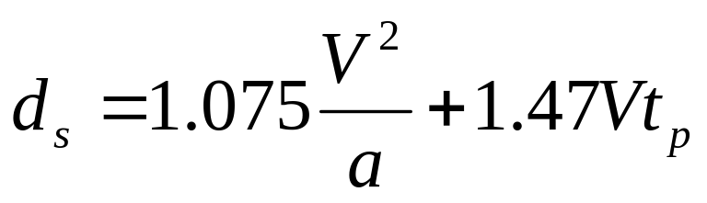
SSD – Quick and Dirty
Acceleration due to gravity, g = 32.2 ft/sec²
There are 1.47 ft/sec per mph
Assume G = 0 (flat grade)
V = V₁ in mph
a = deceleration, 11.2 ft/s² in US customary units
t_{p} = Conservative perception / reaction time = 2.5 seconds

Slide 23
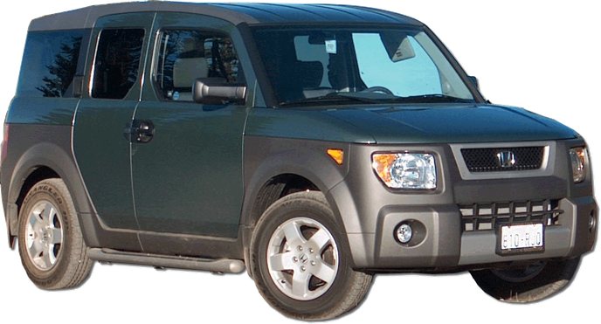

Slide 24
Primary References
Mannering, F.L.; Kilareski, W.P. and Washburn, S.S. (2005). Principles of Highway Engineering and Traffic Analysis, Third Edition). Chapter 2
American Association of State Highway and Transportation Officals (AASHTO). (2001). A Policy on Geometric Design of Highways and Streets, Fourth Edition. Washington, D.C.

